Slide 1
Computing: Arrays

Slide 2
Learning Objective
Learn how to store data in an Array.
Learn the different types of Arrays.

Slide 3
ARRAY
What do we know about Arrays?
Give examples of what arrays can be used for? Give examples of 2D and 3D arrays.

Slide 4
ARRAY
Array in python is similar to Lists
Syntax for creating 1-D array
data_type array_name[size];
e.g. int s[5] = {46, 41, 39, 38, 43}
What does it look like in python? Give it a go.

Slide 5
ARRAY
In Python we use [ ] to create lists
weekdays = [“Monday”, “Tuesday”, “Wednesday”, “Thursday”, “Friday”]
Indexing
Print(weekend[3])
Thursday
Array example
MONDAY | TUESDAY | WEDNESDAY | THURSDAY | FRIDAY

Slide 6
Activity
Create an array for weekdays.
Call the array “week”
Append the array and add Saturday and Sunday to the array.

Slide 7
2-D ARRAY
Syntax for creating 2-D array
data_type array_name[rows][columns];
e.g. int s[3][4] = {{41, 39, 38, 43}, {23, 43, 76, 43}, {12, 11, 23, 99}};
No. of elements = No. of Rows x No. of Columns
What does it look like in python? Give it a go.

Slide 8
2-D ARRAY
Students_grades = [[“Sam”, 76], [“Sally”, 87]]
Indexing
Print(weekend[1][0])
Sally
2-D Array Example
SAM | 76 | B
SALLY | 87 | A
PAUL | 55 | D

Slide 9
Activity 2
Create a 2D array for the results of students in a class.
Create a program so that you can add more students and there grades.
Use indexing to get data from the array.
(use the internet if you need help)

Slide 10
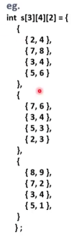
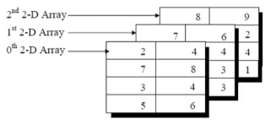
3-D ARRAY
Syntax for creating 3-D array

Slide 11
3-D ARRAY
Write out what a 3d array in python will look like.

Slide 12
3-D ARRAY
Array2x3x4 = [[['a’, 'b’], [‘c’, 'd’], ['e’, 'f']],
[['g’, 'h’], ['i’, 'j’], ['k’, 'l']],
[['m’,'n'], ['o’, 'p’], ['q’, 'r']],
[[ 's’, 't'], ['u’, 'v’], ['w’, 'x']]]
Use indexing to print out the following letters from the array above:
B
F
I
Q
X
A, G, M & S (Hint: use range function)

Slide 13
for x in range(0,4):
print(a2x3x4[x][0][0])

Slide 14
Extension Task:
Create a 2D and 3D array.
Show indexing in both arrays.
Do the 13 exercises on this site.
https://www.w3resource.com/python-exercises/array/

